Slide 1
Everything what you (don’t) know about structures in .NET
Łukasz Pyrzyk Sonova
@lukaszpyrzyk
Notes:
Test note

Slide 2
About me
Born in Blachownia near Częstochowa, lives in Wrocław
Senior Full Stack Cloud Developer at Sonova Group
Former employee of the Volvo, Credit Suisse and Ryanair
Co-founder of Dotnetos
Open source fan & contributor
Lecturer at WSB Wrocław
@lukaszpyrzyk

Slide 3
@lukaszpyrzyk

Slide 4
Structs? Interview?
@lukaszpyrzyk
Notes:
Najlepiej pokazać to pojedynkiem

Slide 5
@lukaszpyrzyk

Slide 6
Why do I always use a class?
Because I can
We don’t need performance, it’s .NET, c’mon man
They are strange, I don’t like them
Because OOP is about objects, inheritance and good style
@lukaszpyrzyk

Slide 7
@lukaszpyrzyk

Slide 8
Structures
C++ - No big difference between classes and structs
Java – Java primitives are value types, but developer is not able to create custom
.NET supports two types of types – Reference Types and Value Types
Value types | Reference types
Struct | Class
Enum | Delegate
 | Interface
@lukaszpyrzyk
Notes:
C++ - difference between default access level and inheritance

Slide 9
class CalcClass
{
public int X;
}
struct CalcStruct
{
public int X;
}
@lukaszpyrzyk

Slide 10
private CalcClass[] classes;
private CalcStruct[] structs;
const int items = 1000_000;
[GlobalSetup]
public void Setup()
{
structs = new CalcStruct[items];
classes = new CalcClass[items];
for (int i = 0; i < items; i++)
{
structs[i] = new CalcStruct { X = i};
classes[i] = new CalcClass { X = i};
}
}
[Benchmark(Baseline = true)]
public int Struct()
{
int result = 0;
for (int i = 0; i < items; i++)
result += structs[i].X;
return result;
}
[Benchmark]
public int Class()
{
int result = 0;
for (int i = 0; i < items; i++)
result += classes[i].X;
return result;
}
@lukaszpyrzyk

Slide 11
@lukaszpyrzyk
Notes:
Struktury były szybsze o około 40 procent

Slide 12
public class Program
{
public int Run()
{
var obj = new TestClass();
obj.X = 5;
return obj.X;
}
}
@lukaszpyrzyk

Slide 13
C.Run()
L0000: mov ecx, 0x1797dc90
L0005: call 0x5f630c8
L000a: mov dword [eax+0x4], 0x5
L0011: mov eax, [eax+0x4]
L0014: ret
TestClass..ctor()
L0000: ret
@lukaszpyrzyk

Slide 14
C.Run()
L0000: mov eax, 0x5
L0005: ret
@lukaszpyrzyk

Slide 15
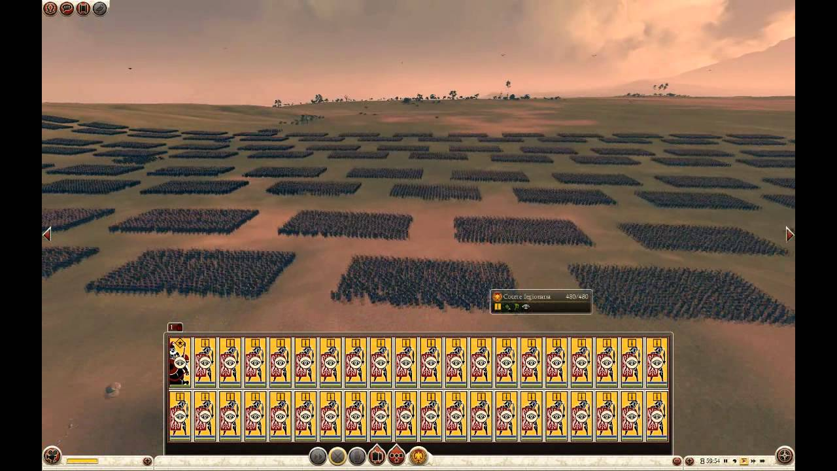
@lukaszpyrzyk

Slide 16
Internal design
Classes
Objects are always allocated on the heap, which is managed by Garbage Collector.
Allocation on the heap is fast, however, deallocation is not deterministic because GC decides when to clean up the memory.
Structs
Structs can be allocated on stack and heap
In method, all local value types are allocated on the stack. When method ends, stack is unwinded. This is super fast
@lukaszpyrzyk

Slide 17
Objects
Every instance of the reference types has two additional fields required and used by .NET runtime
ObjectHeader – mix of flags and values: used by GC, hash code, sync block index. Uses 4 bytes, requires additional padding on x64
MethodTable – pointer to the virtual method table which is a lookup table used to achieve polymorphic behaviors of abstract/virtual override method. Uses size of the pointer
@lukaszpyrzyk

Slide 18
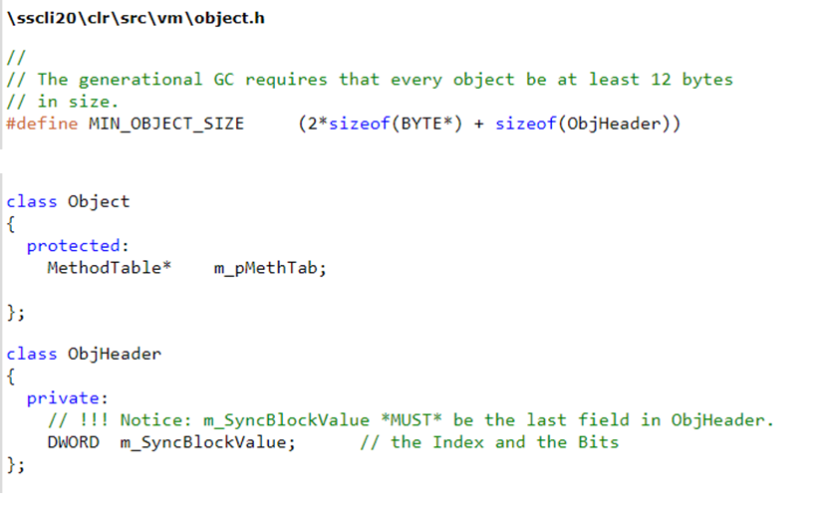
Objects
@lukaszpyrzyk

Slide 19
CPU
@lukaszpyrzyk
Notes:
Z procesorem można zrobić wiele rzeczy, np. takich.
Jednakże, programiści powinni pamiętać o czymś innym..

Slide 20
CPU cache
Hardware cache used by CPU to reduce the average cost of accessing data from the RAM
Most of the CPUs have different, independent caches for instruction (Li) and data caches (Ld)
Usually, cache is organized by hierarchy (L1, L2, L3)
@lukaszpyrzyk

Slide 21
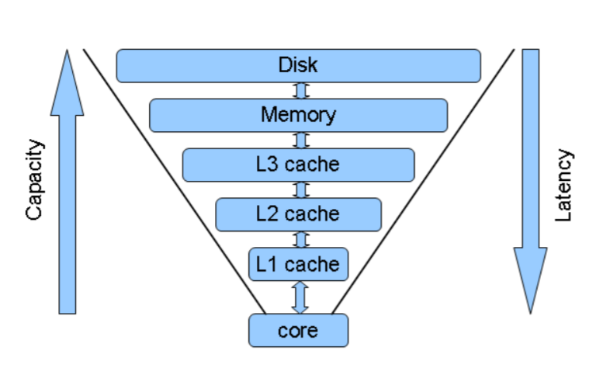
CPU cache
@lukaszpyrzyk

Slide 22
CPU cache
Data is transferred between memory and cache by blocks of fixed size
Usually, those blocks are called cache lines or cache blocks
Cache line is usually 64 bytes, so the processor is prepared to use a near-memory area if it is needed
@lukaszpyrzyk

Slide 23
class CalcClass
{
public int X;
}
struct CalcStruct
{
public int X;
}
@lukaszpyrzyk

Slide 24
CPU cache and x64
64 B
2,67 items in cache line
64 B
16 items in cache line
@lukaszpyrzyk
Notes:
Those additional fields can be used to store data

Slide 25
Size matters
The cost of passing (copying) existing structure depends on its size, with a performance penalty for structs over a certain size
The cost of passing existing object is constant, because it depends on the pointer size
Keep structure small, because CLR optimizes operations on structures below a certain size
If the size is bigger, JIT compiler generates a lot of MOV instructions, what decreases the performance
@lukaszpyrzyk

Slide 26
Size matters
struct TestStruct
{
public int X1;
public int X2;
public int X3;
public int X4;
}
C.Run()
L0000: mov eax, 0x5
L0005: ret
@lukaszpyrzyk

Slide 27
Size matters
C.Run()
L0000: push edi
L0001: push esi
L0002: sub esp, 0x14
L0005: mov esi, ecx
L0007: lea edi, [esp]
L000a: mov ecx, 0x5
L000f: xor eax, eax
L0011: rep stosd
L0013: mov ecx, esi
L0015: lea edi, [esp]
L0018: xor eax, eax
L001a: xorps xmm0, xmm0
L001d: movq [edi], xmm0
L0021: movq [edi+0x8], xmm0
L0026: add edi, 0x10
L0029: stosd
L002a: mov dword [esp], 0x5
L0031: mov eax, [esp]
L0034: add esp, 0x14
L0037: pop esi
L0038: pop edi
L0039: ret
struct TestStruct
{
public int X1;
public int X2;
public int X3;
public int X4;
public int X5;
}
@lukaszpyrzyk

Slide 28
Passing structure
private static double CalculateDistance(Point3D point1, Point3D point2)
{
double x = point1.X - point2.X;
double y = point1.Y - point2.Y;
double z = point1.Z - point2.Z;
return Math.Sqrt(x * x + y * y + z * z);
}
Point3D contains three doubles. Double has 8 bytes, so the whole structure holds 24 bytes.
Passing point1 and point2 requires copying 48 bytes
@lukaszpyrzyk

Slide 29
Passing structure by ref
private static double CalculateDistance(ref Point3D point1, ref Point3D point2)
{
double x = point1.X - point2.X;
double y = point1.Y - point2.Y;
double z = point1.Z - point2.Z;
return Math.Sqrt(x * x + y * y + z * z);
}
By passing structure by reference, you pass 4 or 8 bytes to the arguments, depending on the architecture of the machine.
But… You can modify the values
@lukaszpyrzyk

Slide 30
Passing structure by in
private static double CalculateDistance(in Point3D point1, in Point3D point2)
{
double x = point1.X - point2.X;
double y = point1.Y - point2.Y;
double z = point1.Z - point2.Z;
return Math.Sqrt(x * x + y * y + z * z);
}
Allows to pass structure by reference and block any modification
in modifier may be applied to any member that takes parameters: methods, delegates, lambdas, local functions, indexers, operators
Available in C# 7.2
@lukaszpyrzyk

Slide 31
Passing structure by in
https://github.com/aspnet/SignalR/pull/1900
@lukaszpyrzyk

Slide 32
Inheritance
You cannot inherit from structure
All structs are derived from class System.ValueType
Class System.ValueType derives from System.Object
struct CalcStruct
{
public int X { get; set; }
public override int GetHashCode() => “4Developers".GetHashCode();
}
@lukaszpyrzyk

Slide 33
Boxing and unboxing
Boxing is a proces of converting Value Type to the reference type. CLR wraps the value inside new object and stores it on the heap.
int age = 23;
object ageOnTheHeap = (object)age;
object ageOnTheHeap = age;
Unboxing is a conversion from object into value type int ageAgain = (int)ageOnTheHeap;
@lukaszpyrzyk

Slide 34
Boxing
struct CalcStruct
{
public int X; public override bool Equals(object obj)
{
return obj is CalcStruct && ((CalcStruct)obj).X == X;
}
}
@lukaszpyrzyk
Notes:
Słownik, lista

Slide 35
Boxing
struct CalcStruct : IEquatable<CalcStruct>
{
public int X; public override bool Equals(object obj)
{
return obj is CalcStruct && Equals((CalcStruct)obj);
}
public bool Equals(CalcStruct other) => X == other.X;
public override int GetHashCode() => X.GetHashCode();
}
@lukaszpyrzyk

Slide 36
Boxing
public struct CalcStruct : IPrintable
{
public int X;
public void Print() => Console.WriteLine(X);
}
interface IPrintable
{
void Print();
}
@lukaszpyrzyk

Slide 37
Boxing
static void Main(string[] args)
{
var v = new CalcStruct();
Print(v);
}
private static void Print(IPrintable itemToPrint) => itemToPrint.Print();
@lukaszpyrzyk

Slide 38
Boxing
static void Main(string[] args)
{
var v = new CalcStruct();
Print(v);
}
private static void Print(IPrintable itemToPrint) => itemToPrint.Print();
private static void Print<T>(T itemToPrint) where T : struct, IPrintable
{
itemToPrint.Print();
}
@lukaszpyrzyk

Slide 39
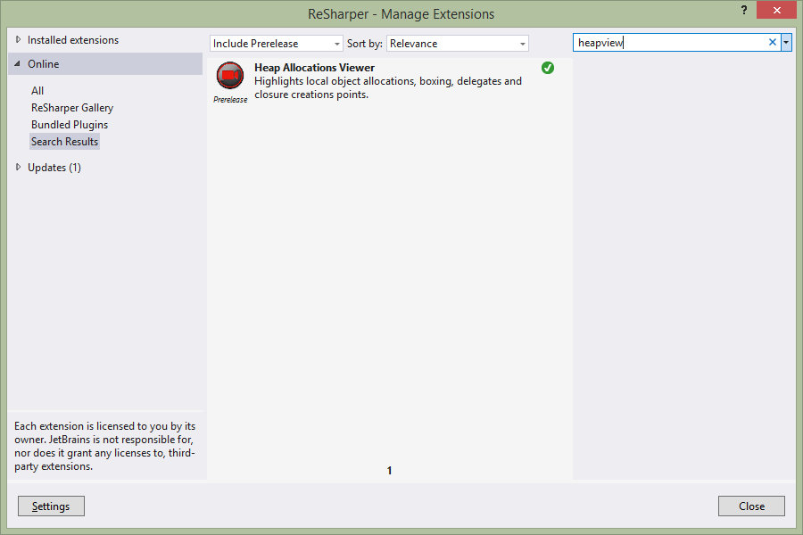
@lukaszpyrzyk

Slide 40
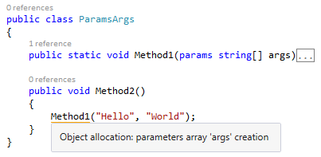
Boxing
@lukaszpyrzyk

Slide 41
GetHashCode
public struct CalcStruct
{
public int X { get; set; }
}
static void Main(string[] args)
{
var first = new CalcStruct { X = 4 };
var second = new CalcStruct { X = 4 };
Console.WriteLine(first.GetHashCode() == second.GetHashCode());
}
@lukaszpyrzyk

Slide 42
@lukaszpyrzyk
Notes:
TRUE

Slide 43
GetHashCode
public struct CalcStruct
{
public int X { get; set; }
public int Y { get; set; }
}
static void Main(string[] args)
{
var first = new CalcStruct { X = 1, Y = 1 };
var second = new CalcStruct { X = 1, Y = 2 };
Console.WriteLine(first.GetHashCode() == second.GetHashCode());
}
@lukaszpyrzyk

Slide 44
@lukaszpyrzyk
Notes:
TRUE

Slide 45
GetHashCode
public struct CalcStruct
{
public int X { get; set; }
public short Y { get; set; }
}
static void Main(string[] args)
{
var first = new CalcStruct { X = 1, Y = 1 };
var second = new CalcStruct { X = 1, Y = 2 };
Console.WriteLine(first.GetHashCode() == second.GetHashCode());
}
@lukaszpyrzyk

Slide 46
@lukaszpyrzyk
Notes:
TRUE

Slide 47
GetHashCode
public struct CalcStruct
{
public int X { get; set; }
public string Y { get; set; }
}
static void Main(string[] args)
{
var first = new CalcStruct { X = 1, Y = "hello" };
var second = new CalcStruct { X = 1, Y = "world" };
Console.WriteLine(first.GetHashCode() == second.GetHashCode());
}
@lukaszpyrzyk

Slide 48
Notes:
TRUE

Slide 49
GetHashCode
If struct has a gasp or any reference type, HashCode is calculated from the first value type
In another case, CLR calculates the hash by xor-ing all bits. This is a ‚correct' hash, because all fields in the struct participate in the hash code.
@lukaszpyrzyk

Slide 50
Summary
Object has two addicional field required by CLR
Smallest .NET object has 12 bytes on x32, 24 on x64
Structs don’t have them
Allocation and deallocation of local value types is extreamly fast
Size matters
It is easy to accidentally box value type
GetHashCode implementation is tricky, you should not rely on it
@lukaszpyrzyk

Slide 51
Bibliography
http://geekswithblogs.net/akraus1/archive/2012/07/25/150301.aspx
https://codeblog.jonskeet.uk/2011/04/05/of-memory-and-strings/
http://netinverse.com/devblogs/debugging/advanced-net-debugging-clr-objects-internal-structure/626/
http://adamsitnik.com/Value-Types-vs-Reference-Types/
https://github.com/kkokosa/Tune
https://sharplab.io
@lukaszpyrzyk

Slide 52
Thank you!
Łukasz Pyrzyk
@lukaszpyrzyk
https://pyrzyk.net
https://dotnetos.org
lukasz.pyrzyk@gmail.com

